Slide 1
Mid-term thesis presentation (27/02/2023)
THE EFFECTIVITY OF WEIRS FOR THE LOCAL GROUNDWATER RECHARGE IN THE CATCHEMENT OF THE GONDEBEEK
–
Anne-Marie Braspenning

Slide 2
DATA ANALYSIS

Slide 3
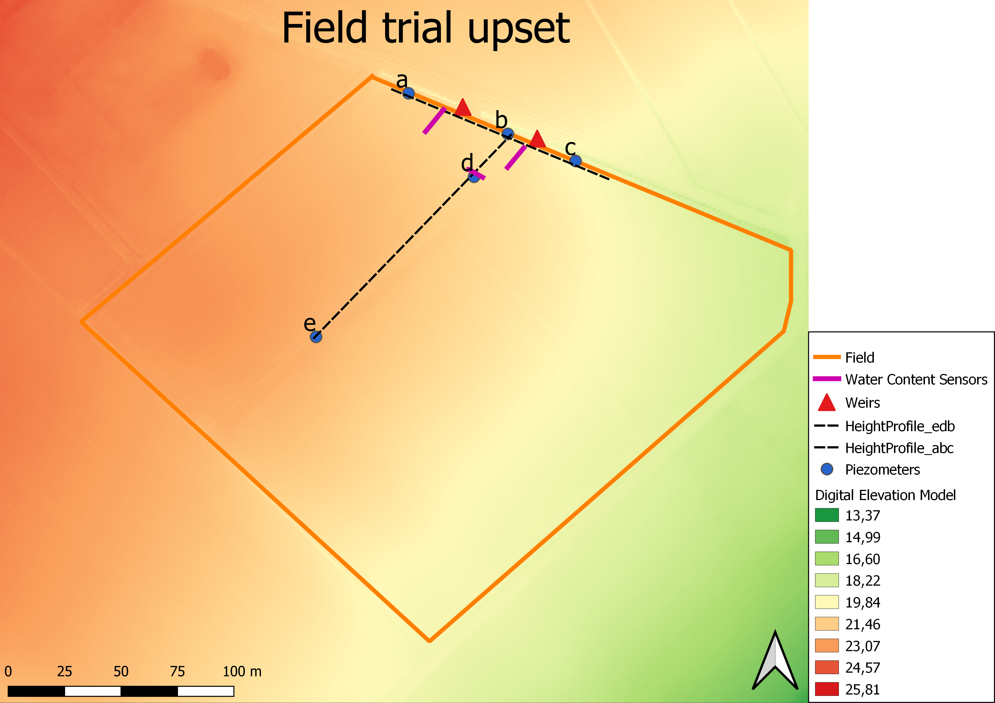
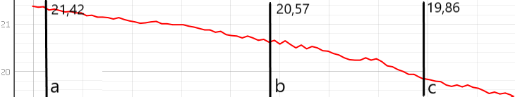
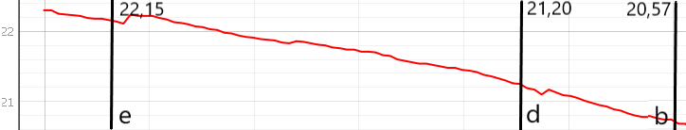

Slide 4
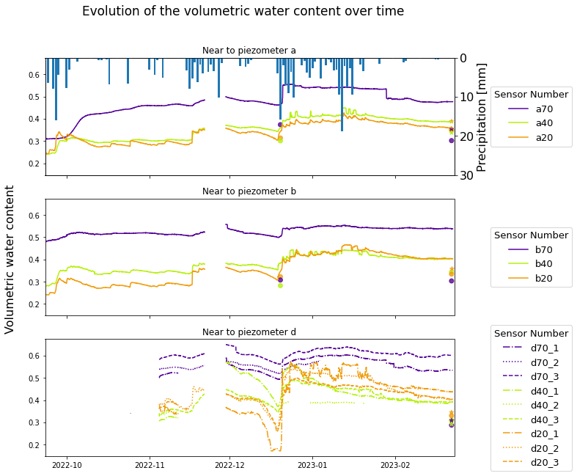
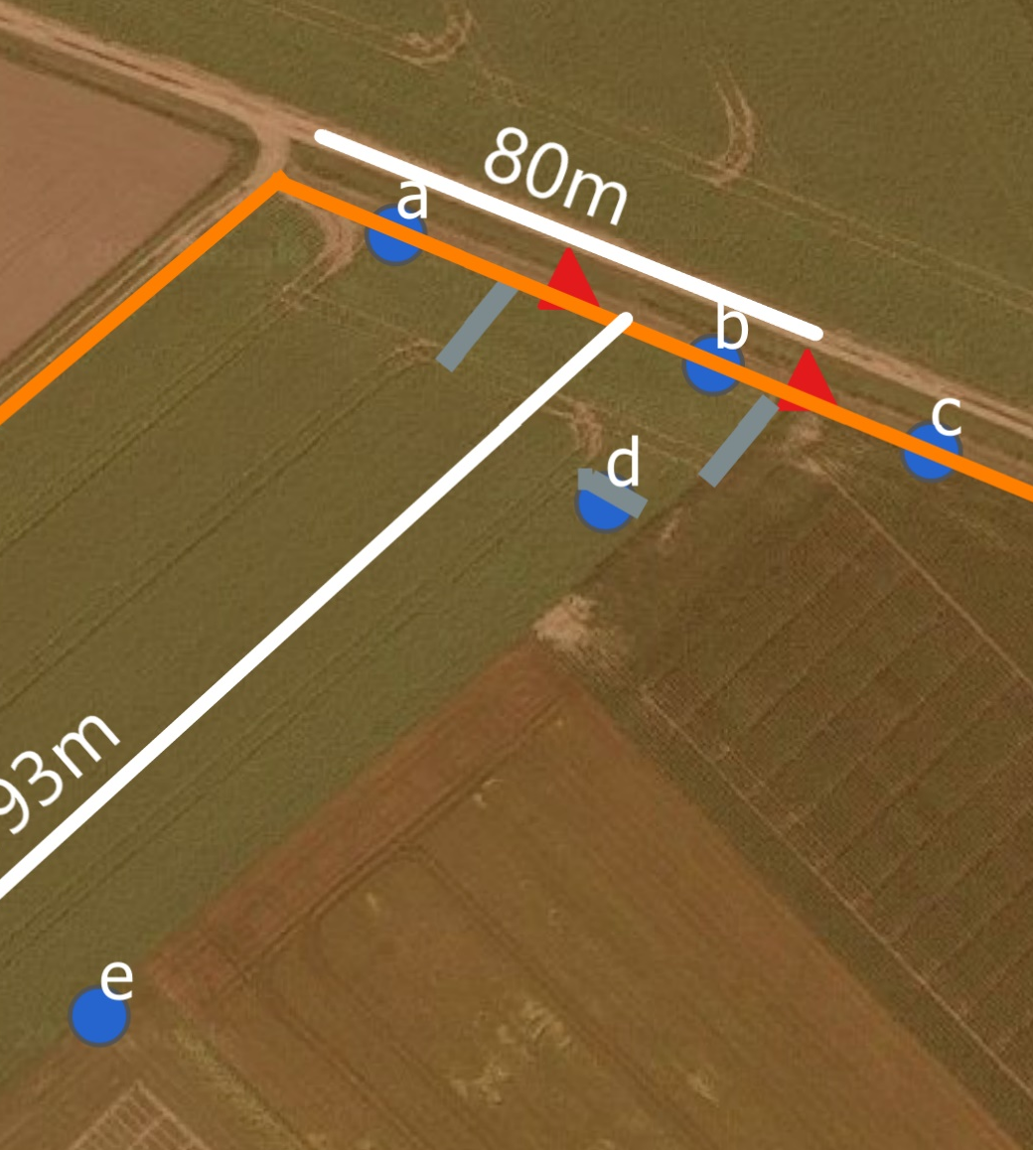

Water Content Sensors
Volumetric water content
Based on gravimetric water content: θv = θg * BD
Volumetric water content measured with Kopecky ring

Slide 5
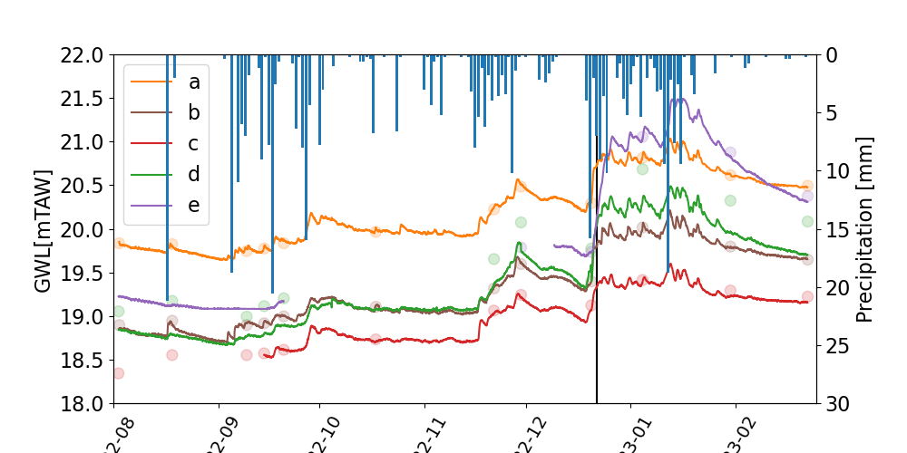
Piezometers: Groundwater level [mTAW]

Slide 6
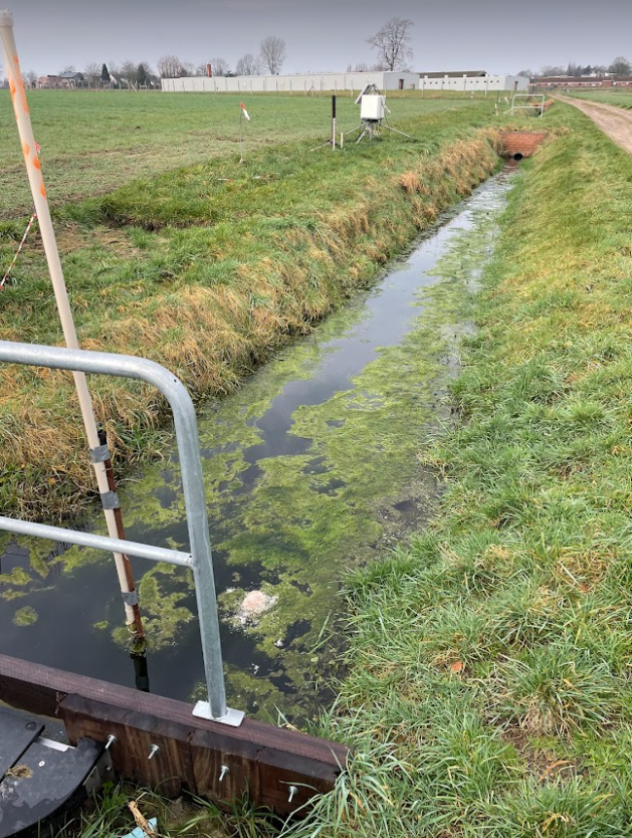
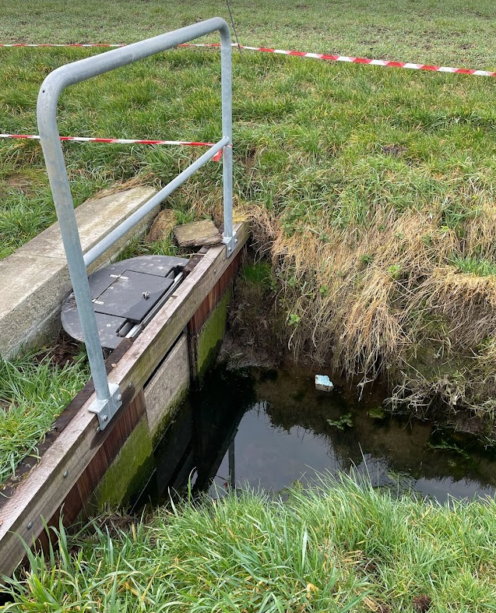
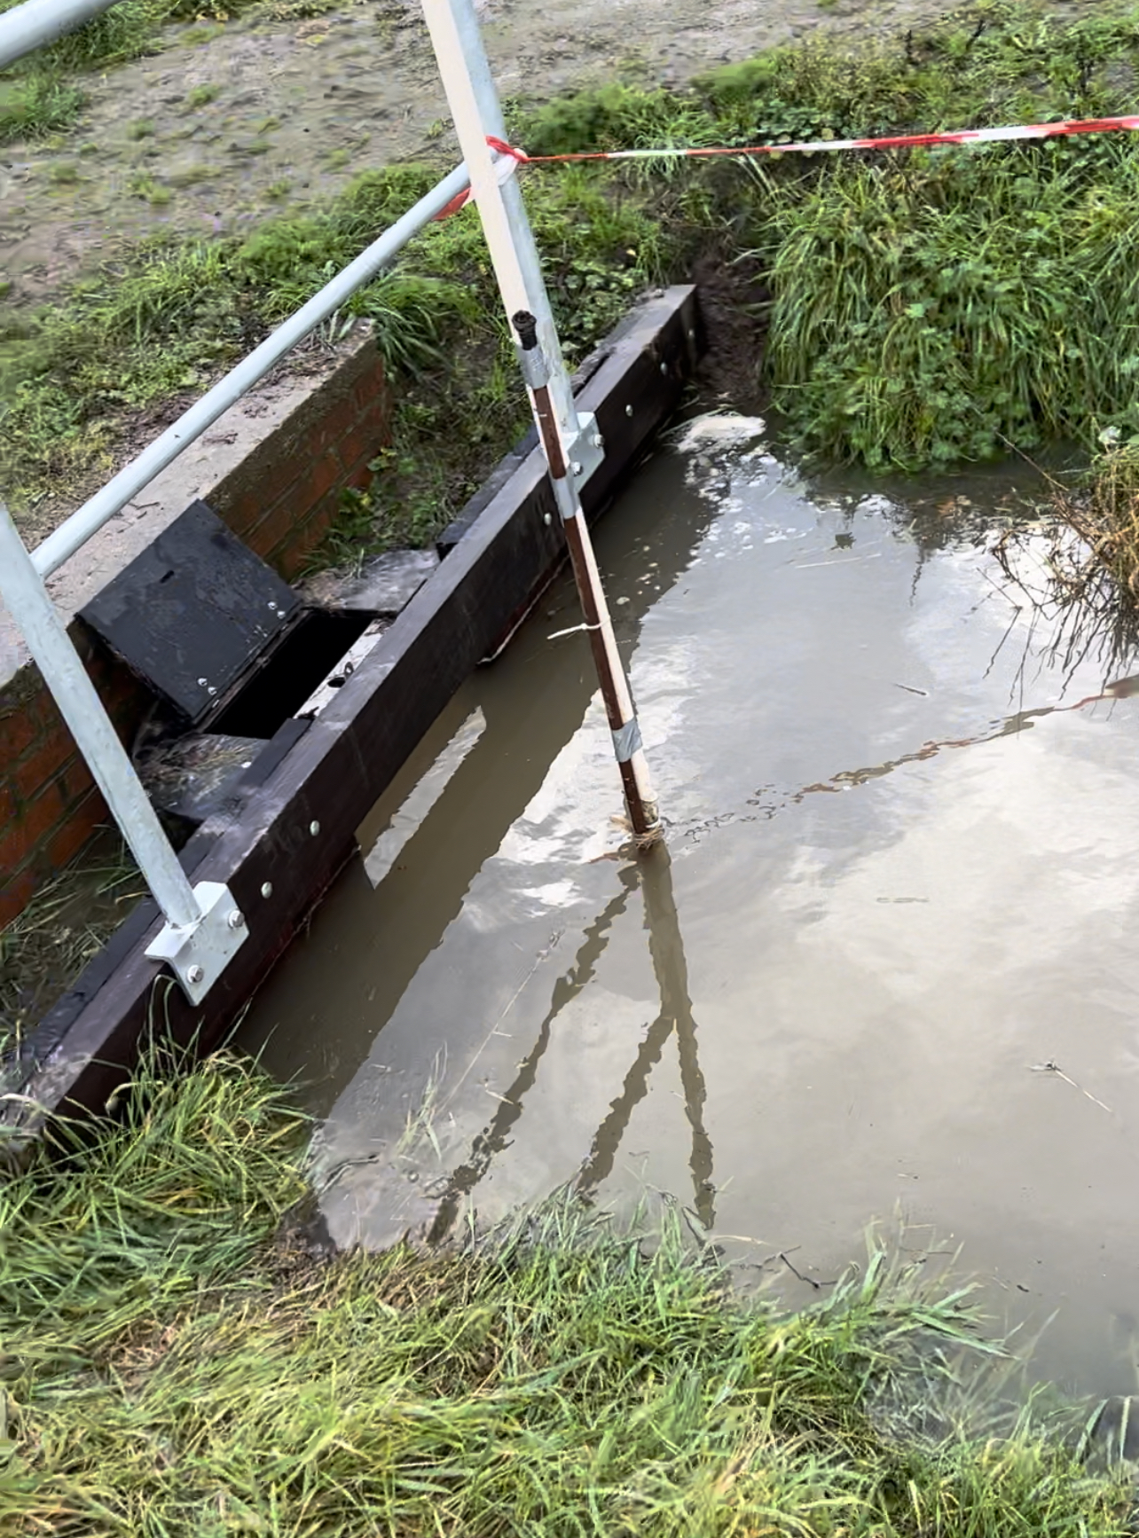
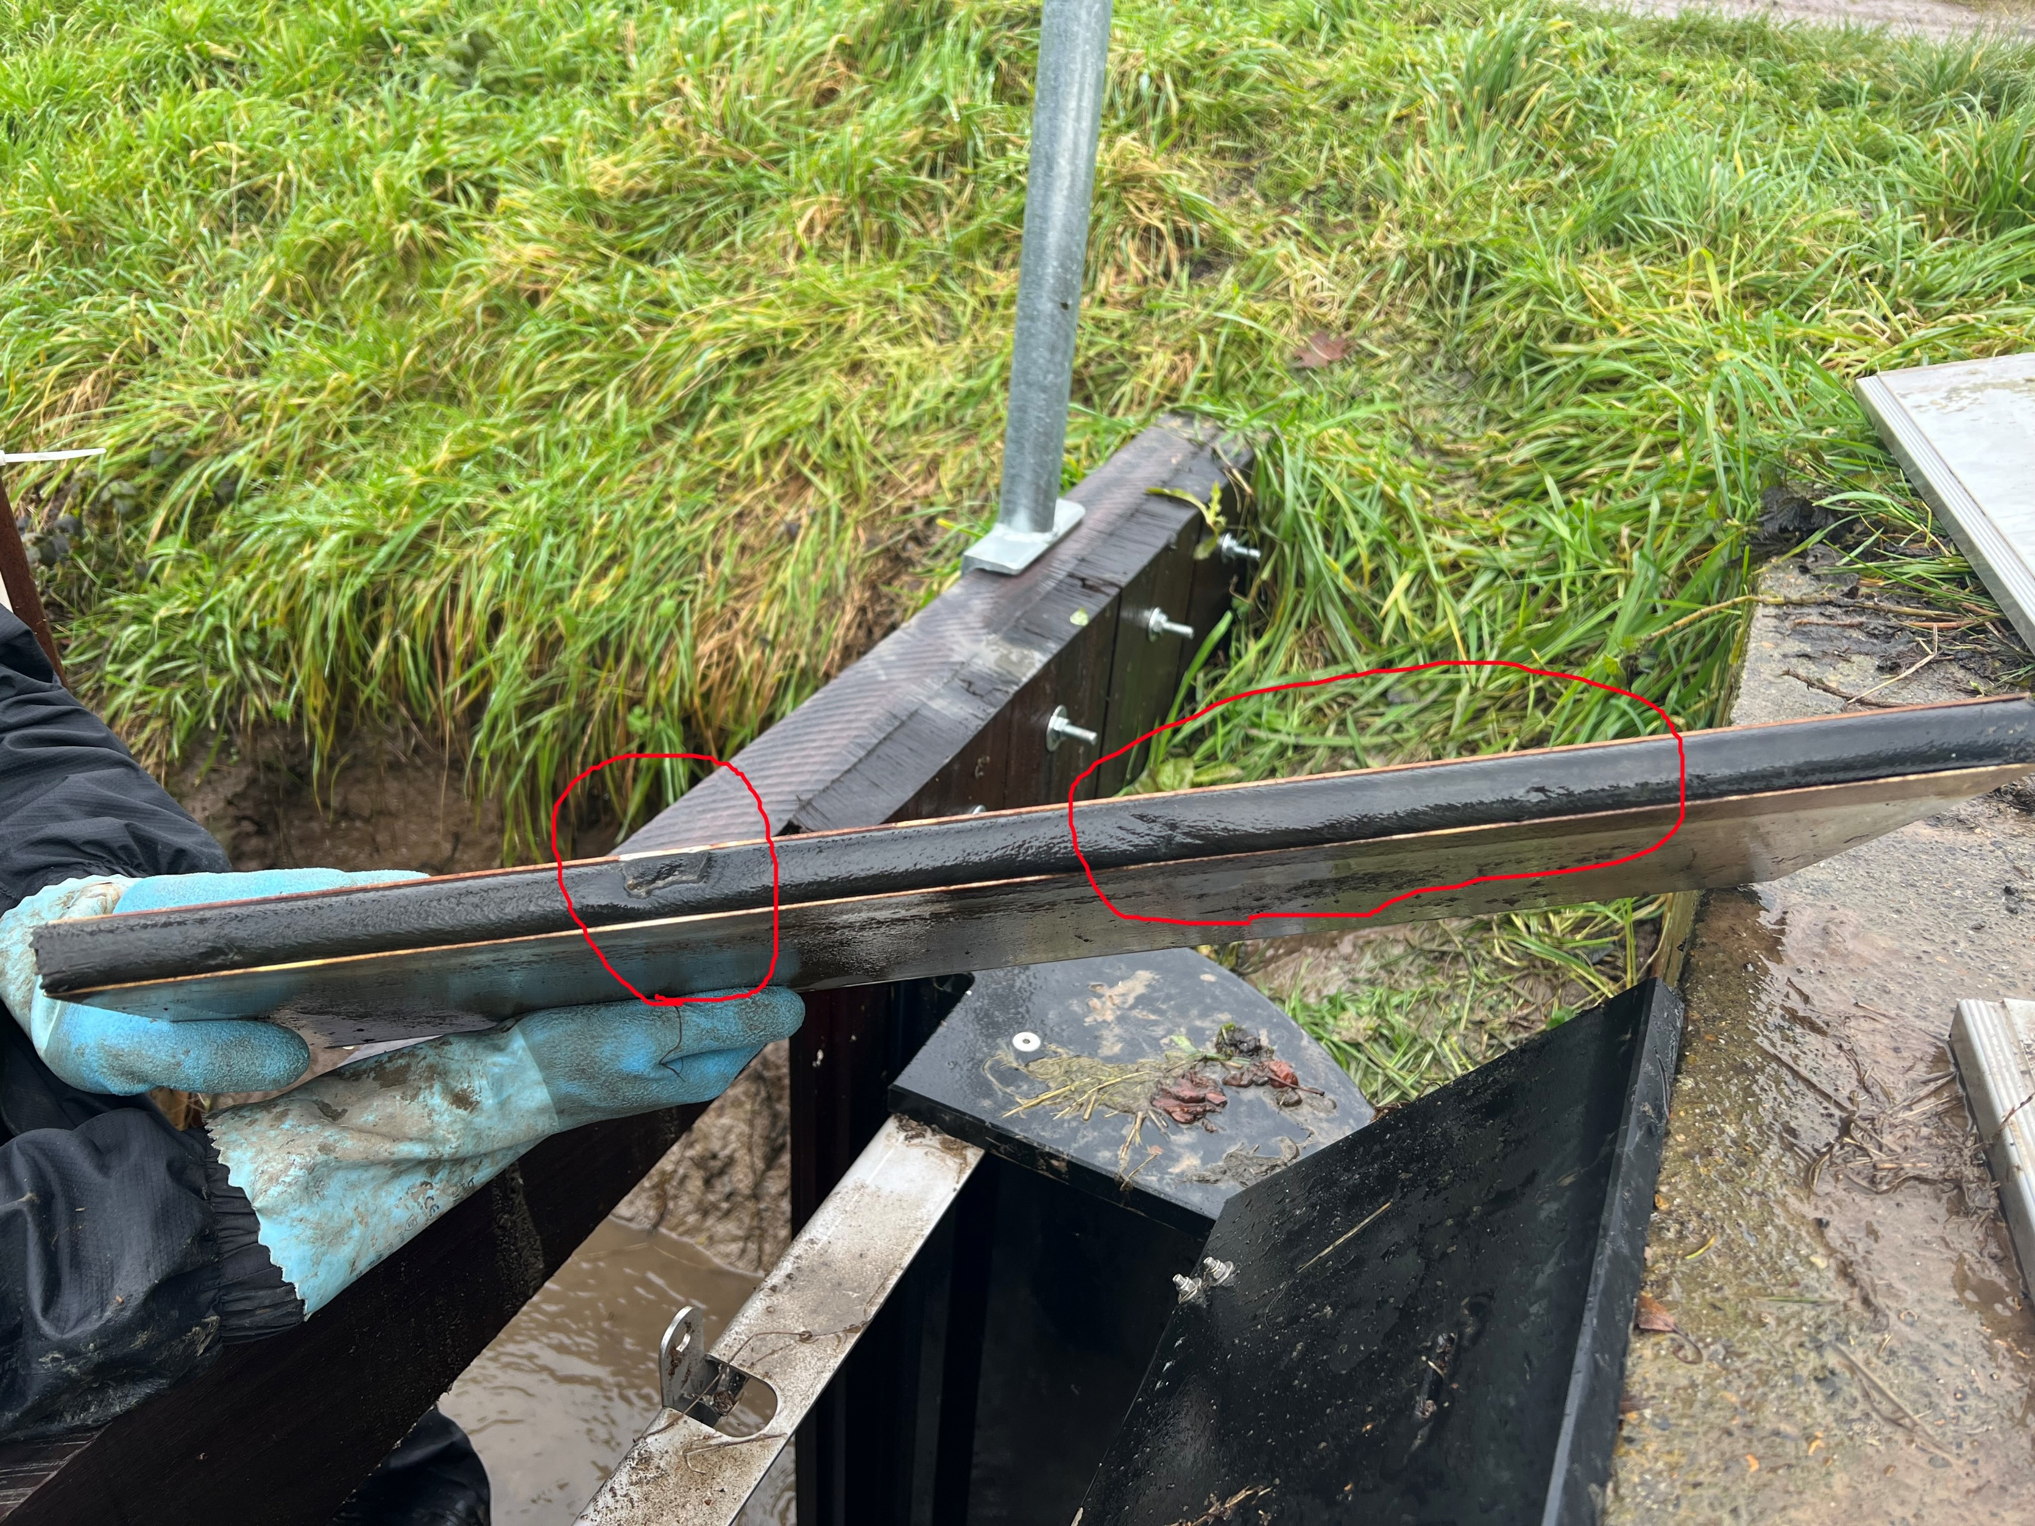
22/02/2023
Weir 2
Weir 1
23/12/2022

Slide 7
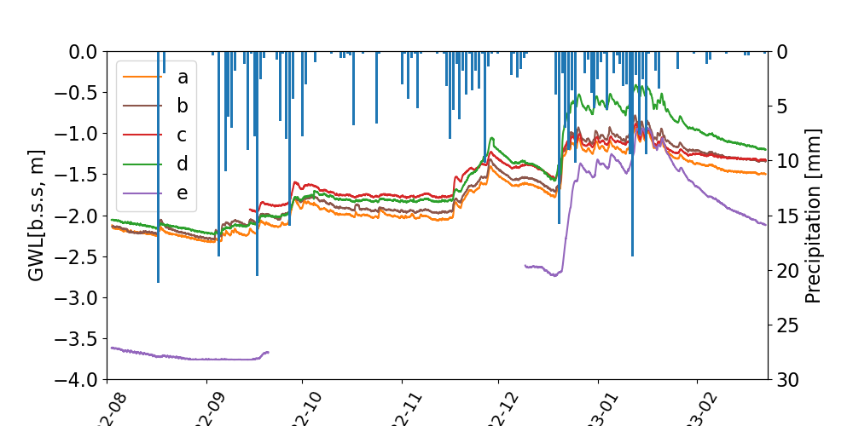
Piezometers: Below surface depth [m]

Slide 8
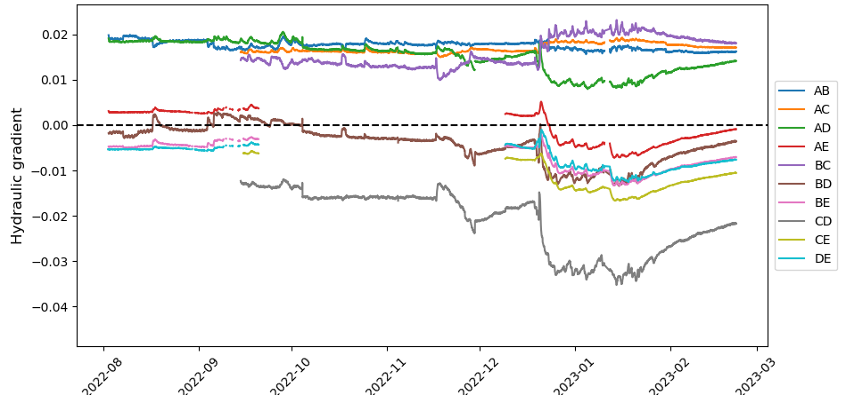
Piezometers: Hydrualic gradients

Slide 9
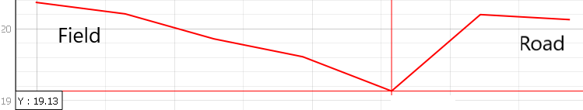
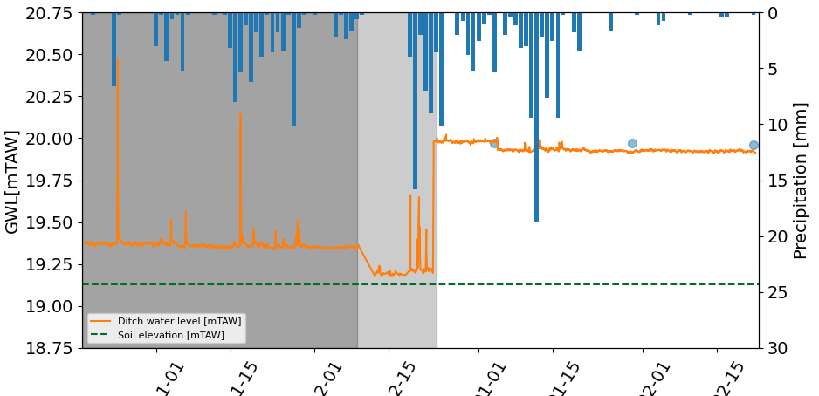
Ditch water level

Slide 10
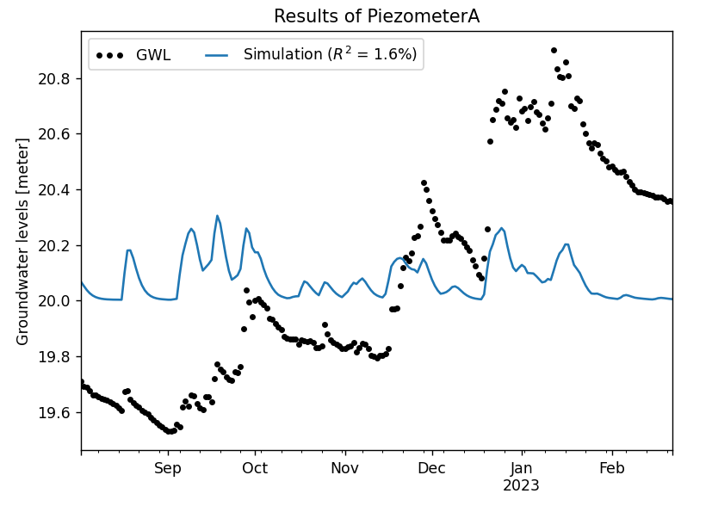
What is next?
Fix ditch water level
Last data point?
Open weirs?
Time series analysis: ‘PASTAS’
With precipitation
Link with ditch water level?

Slide 11
HYDRUS MODELLING

Slide 12
2D simulation for 1 piezometer → produce the same trend?
22/09/2022 – 30/01/2023
BC: variable head → variable ditch water level
IC: water content: wrong calculations
Pressure head: equilibrium at 1800cm
3D simulation: 3D layered with thickness vectors
How to implement different groundwater levels?

Slide 13
Planning
31/03 (5 weeks): Time series + Hydrus (practical work + material & methods)
Easter holidays: Literature study + material methods + first results
Personal deadline: 07/05 (3 weeks): finalize the results

